Slide 1
Does basic image augmentation
change CNN classification
performance?
Maaz Shaikh | Research and question lead
Sankeerth Reddy | Analysis lead
Aditi Patel | Evidence and presentation lead
A pre-registered paired comparison on a CIFAR-10 subset
Group 1 · CNN pathway: Image Preprocessing
Statistics for AI Residency · August 2026
Notes:
Good morning. We are Group 1, on the CNN image-preprocessing pathway. Our question is whether basic image augmentation actually changes how well a CNN classifies. We pre-registered our hypotheses before running the experiment, which turned out to matter a great deal.

Slide 2
1
The Problem, and our Question
Augmentation is applied as a default in image classification.
Its justification carries an unstated condition: it is a regularizer.
Regularization helps a model that is fitting its training data too closely.
Does it help a model that has not fit its data yet?
3 epochs
10 seeds
training budget
per condition
Research question
Does basic augmentation — horizontal flip, ±18° rotation, ±10% zoom — change the test accuracy or the generalization gap of a fixed two-convolutional-layer CNN on a 10,000-image CIFAR-10 subset, relative to an identical unaugmented model, across ten paired random seeds?
Our baseline never reached the situation augmentation is designed for. That is the finding.
Maaz Shaikh
Notes:
Everyone augments — it is a default. But the justification assumes you are in a particular situation: that your model is memorising and needs restraining. We had a three-epoch budget and wanted to know whether the default still earns its place there. That turned out to be exactly the right question, because our baseline never reached the situation augmentation is designed for.

Slide 3
2
What the research told us, and what we did
Source | What it established | What we did about it
Lin et al. (2024) JMLR | Augmentation is an implicit spectral regularizer; its effect is regime-dependent | Did not predict an accuracy gain
Alomar et al. (2023) Journal of Imaging | On reduced CIFAR-10, rotation causes "loss of a significant amount of pixel information" | Rejected the ±36° setting
Ottoni et al. (2023) IJMLC | Selective tuning beat all-transforms: 88.0% vs 64.7% mean accuracy | Treated intensity as a decision needing evidence
Roberts et al. (2021) Nature Machine Intelligence | 62 quality-screened studies: "none have potential clinical utility" | Wrote strict claim boundaries
These did not decorate the report — they changed what we did.
Maaz Shaikh
Notes:
These four sources did not decorate the report — they changed what we did. Lin is why we did not predict improvement, which felt counterintuitive but followed from the evidence. Alomar is why we rejected the strongest augmentation setting. Ottoni is why we treated intensity as a decision requiring justification. Roberts is why our conclusion is narrower than it could have been.

Slide 4
3
Data, Variables and Preprocessing
CIFAR-10, 32×32×3, 10 balanced classes
10,000 train / 2,000 validation / 3,000 test - fixed subset, data seed 42, identical across every run
Normalized 0–255 → 0-1. No resizing: 32×32 is the point, not a limitation to fix
IV: Augmentation off / on. DV: Test Accuracy, Generalization Gap
Held constant: Architecture, Adam, 3 epochs, batch 64, all split sizes
282,250
93%
total parameters
in the dense head
The two convolutional layers hold about 19,000 parameters between them. The "CNN" part of this CNN is tiny.
Architecture is unchanged from the provided baseline — altering it would break the assigned comparison.
Sankeerth Reddy
Notes:
One number worth pausing on: 93% of the parameters sit in the fully-connected head. The two convolutional layers hold about 19,000 between them. That is a target for a future architecture change, but not for this experiment — changing the architecture would break the comparison we were assigned.

Slide 5
4
Mathematical foundation: Macro Recall
Recall (one class) = TP / (TP + FN) Macro Recall = Mean of the 10 per-class recalls
TP — really class k, predicted k
FN — really class k, predicted as something else
FP — another class predicted as k. Not in recall; it lives in precision
Macro: every class weighted equally, whatever its size
Reveals: per-class coverage a single accuracy figure averages away
What it hides
Our macro recall of 51.4% averages bird at 0.32 with truck at 0.64 — a 32-point spread the single number conceals.
It also ignores precision entirely. Truck has our best recall (0.64) and one of our worst precisions (0.51): the model uses it as a dumping ground for uncertain images, and recall rewards exactly that.
One number would have told us truck was our best class. It is not.
Sankeerth Reddy
Notes:
Recall asks: of everything that really was this class, how much did the model find? Macro gives every class equal weight. The interesting part is what it hides. Our macro recall is 51.4%, but that averages numbers from 0.32 to 0.64 — a spread you cannot see. And recall ignores precision completely. Truck has our best recall and one of our worst precisions, which means the model dumps uncertain images into truck and recall rewards it. One number would have told us truck was our best class. It is not.

Slide 6
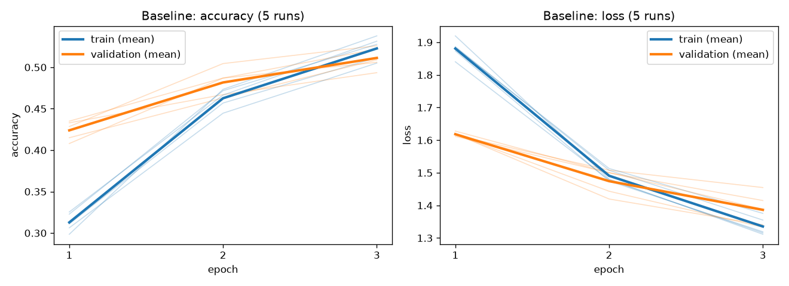
5
Baseline: Model is Underfitting
51.35%
3.77 pp
test accuracy
noise floor
Validation accuracy sits above training accuracy for two of three epochs
Validation loss is still falling at epoch 3 — the model has not begun to memorise
Five identical models, seed the only difference: 49.50% to 53.27%
Augmentation had nothing to fix — and our noise floor is larger than most augmentation effects reported at this scale. Everything after this slide is shaped by that number.
Sankeerth Reddy
Notes:
Two things here decided the whole project. First, we are not overfitting — validation loss is still going down, so the model has not started memorising. Augmentation had nothing to fix. Second, and this surprised us: five identical models differing only in random initialisation spanned 3.77 percentage points. That is our noise floor, and it is larger than most augmentation effects reported at this scale.

Slide 7
6
One Controlled Change
Augmentation off → on, horizontal flip + RandomRotation(0.05) = ±18° + RandomZoom(0.10) = ±10%
Why moderate, not stronger
Why we paired by seed
±36° on a 32×32 image destroys a substantial fraction of it (Alomar et al., 2023)
Stacking all transforms underperformed selective choice (Ottoni et al., 2023)
Severe transforms push samples outside the class vicinity (Xu et al., 2023)
Both conditions run on the same ten seeds, compared within seed
Shared initialisation means much of the 3.77 pp cancels out of the difference
Wilcoxon at n = 5 cannot reach p < 0.05 — its minimum two-tailed p is 0.0625
Hypotheses were written down and committed to git before a single augmented model was trained.
Aditi Patel
Notes:
We committed our hypotheses to version control before training a single augmented model. That is not ceremony — if we had looked at the result first, any hypothesis we then wrote would have been guaranteed correct and would have carried no information. And we deliberately did not predict that augmentation would improve accuracy, because our own baseline evidence said it should not.

Slide 8
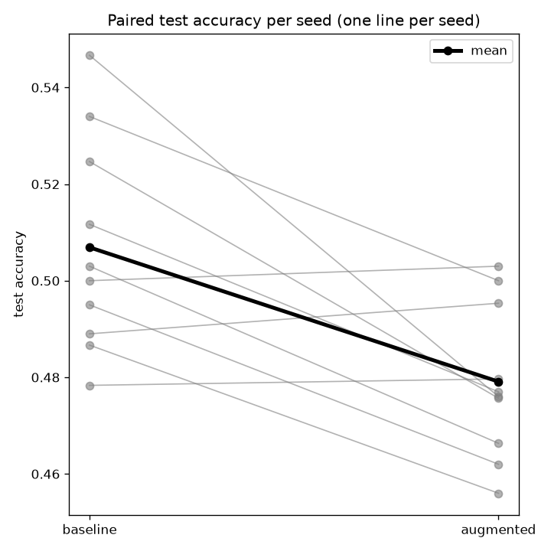
7
Comparison: Both Pre-Registered Nulls Rejected
 | Test accuracy | Generalization gap
Mean paired difference | −2.78 pp | −2.01 pp
95% confidence interval | [−4.54, −1.02] | [−3.10, −0.92]
Paired t (df = 9) | −3.573, p = 0.006 | −4.164, p = 0.0012
Wilcoxon signed-rank | p = 0.027 | p = 0.0029
Cohen's d | −1.13 | −1.32
Seeds in that direction | 7 of 10 | 9 of 10
7 of 10
seeds moved down on accuracy
9 of 10
seeds narrowed the gap
Our effect of 2.78 pp is smaller than our own 3.77 pp noise floor. It reached significance through consistency across ten paired seeds, not through magnitude — a single run each way could not have found it.
Aditi Patel
Notes:
Two results that look contradictory. Augmentation made accuracy significantly worse — 2.78 points, p equals 0.006, and the confidence interval does not cross zero. But it also significantly reduced the generalization gap, which is what augmentation is supposed to do. The next slide explains why those are not in conflict. One thing to flag now: our effect is smaller than our own noise floor. It reached significance through consistency across ten paired seeds, not through size.

Slide 9
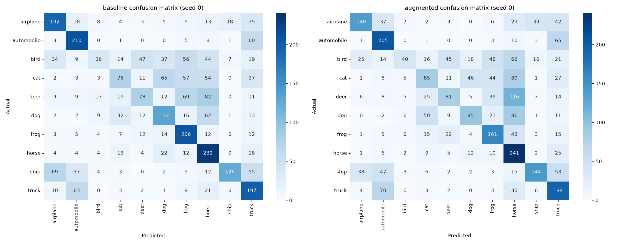
8
Gap closed from the wrong side
 | Baseline | Augmented | Change
Clean train accuracy | 0.5428 | 0.4993 | −4.35 pp
Clean validation accuracy | 0.4986 | 0.4752 | −2.34 pp
Generalization gap | 0.0442 | 0.0241 | −2.01 pp
Both terms fell — training nearly twice as far as validation. The gap narrowed because training performance collapsed toward validation, not because generalization improved.
0.252 → 0.172
0.643 → 0.705
bird recall
a 32% relative loss
automobile recall
but precision fell too
A shrinking gap is normally read as better generalization. Reported alone, it would have told us the opposite of the truth.
Aditi Patel
Notes:
This is the finding we are most pleased with. A shrinking train-validation gap is normally read as better generalization. Ours shrank because training accuracy collapsed toward validation accuracy — everything got worse, training just got worse faster. The gap is a difference between two numbers and tells you nothing about their level. If we had reported it alone we would have concluded the opposite of the truth. And the damage was not spread evenly: bird recall lost nearly a third of its value.

Slide 10
9
Finding, Limitation, Next Step
Finding — Augmentation reduced test accuracy by 2.78 pp while reducing the gap by 2.01 pp. Both terms of the gap fell.
Implication — Augmentation is a regularizer, and a model that has not overfit has nothing to regularize (Lin et al., 2024). It is not a free default under a short budget.
Replication — Notebook's independent re-run reproduced both findings more strongly: −3.75 pp accuracy and −2.96 pp gap, with 10 of 10 seeds agreeing.
Limitation — Seeding did not make our pipeline reproducible: identical configurations differ by ~1.57 pp per seed across runs. One architecture, one budget, one dataset.
We do not claim — Anything about fairness, robustness or real-world readiness (Roberts et al., 2021).
Next step
Run a flip-only condition on the same ten seeds. It isolates rotation and zoom — this transforms the low-resolution literature flags as risky — from the one transform with a genuine domain invariance.
Cost: about 80 seconds.
References
Alomar et al. (2023) · Åkesson et al. (2024) · Coakley & Gundersen (2026) · Lin et al. (2024) · Northcutt et al. (2021) · Ottoni et al. (2023) · Roberts et al. (2021) · Xu et al. (2023)
Questions
Aditi Patel
Notes:
The obvious next step would be "train for more epochs", but ours is sharper and cheaper. We already know which transform in our bundle has a genuine domain invariance — a mirrored car is still a car — and which two might be destroying information at 32 by 32. Eighty seconds of compute would tell us which one is responsible. Happy to take questions.

